Slide 1

Customer Retention
Submitted by,
Ekansh Gupta

Slide 2
PROBLEM STATEMENT
Success of online shopping stores is directly related to customer satisfaction. As per some researches ,customer satisfaction is related to several factors.
This case study is aimed at identifying different factors which contributes to customer satisfaction and hence repeat purchase intention (Customer Retention) and how these factors affect the retention.

Slide 3
EDA Steps
Checking shape of data.
Checking data types of each features using dataframe.info() function.
Displaying each categorical attribute values in terms of percentage.
Univariate analysis by viewing distribution of each attribute using seaborn distplot.
Countplot to see the counts of each attribute.
Bivariate analysis by adding hue parameter to seaborn plot and keeping ‘x’ parameter as ‘purchase frequency of customer’.
Bivariate analysis by making a copy of dataset containing only high purchase frequency customers ,in order to get insights on retention.
Multivariate analysis using grouping technique.

Slide 4
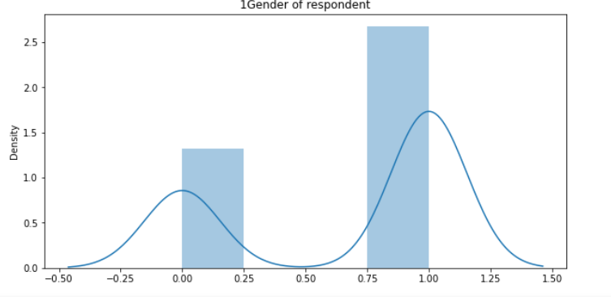
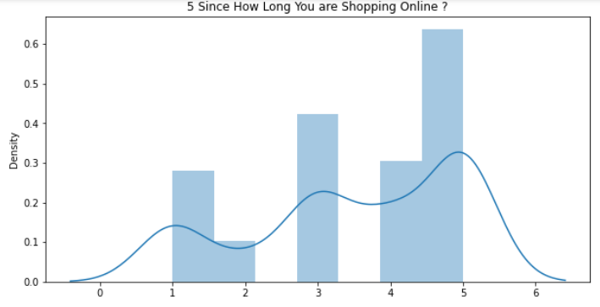
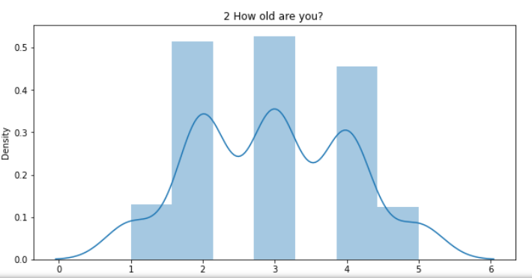
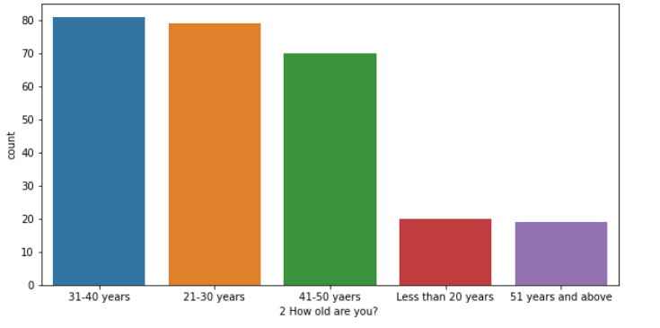
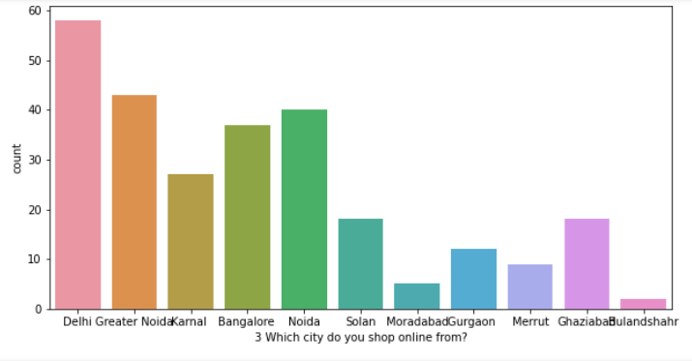
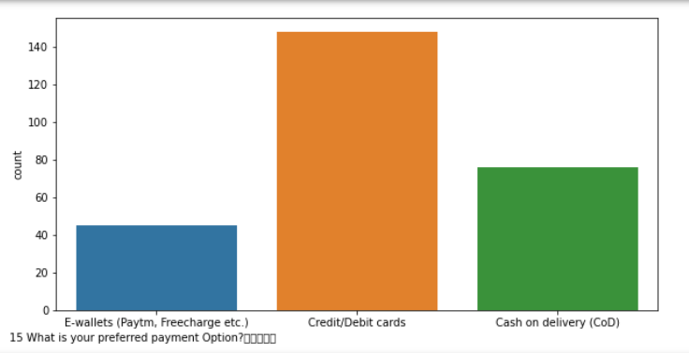
Visualizations done during EDA
Some examples Univariate analysis

Slide 5
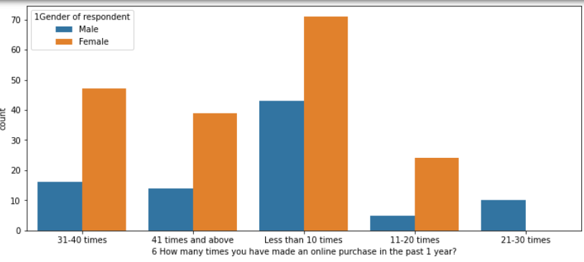
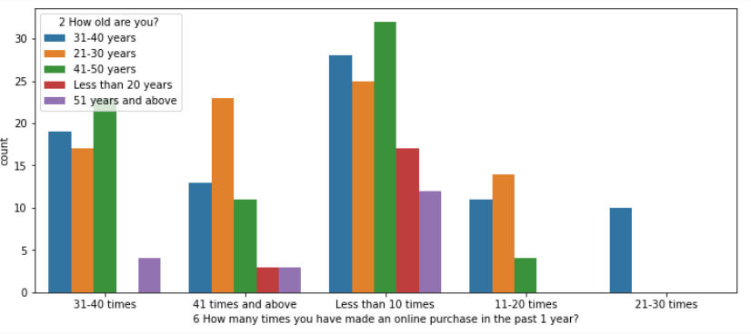
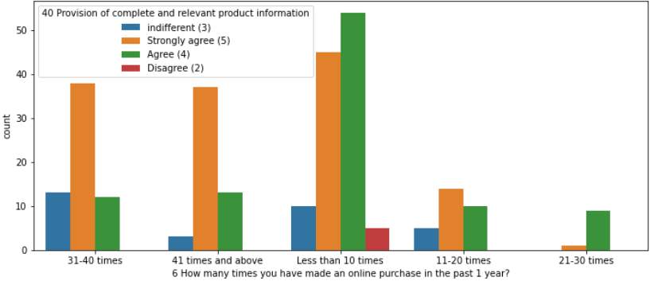
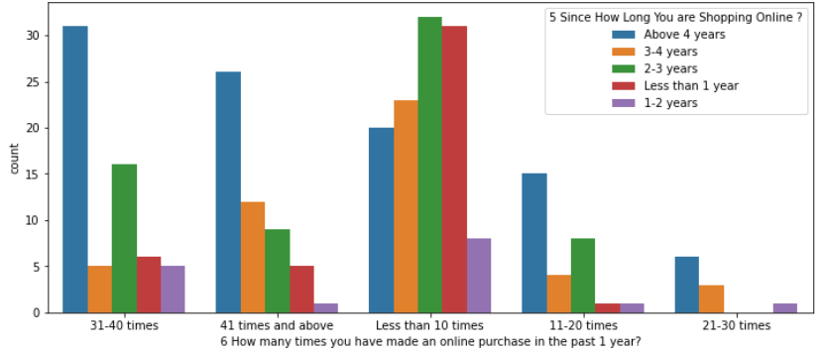
Visualizations done during EDA
Bivariate analysis examples

Slide 6
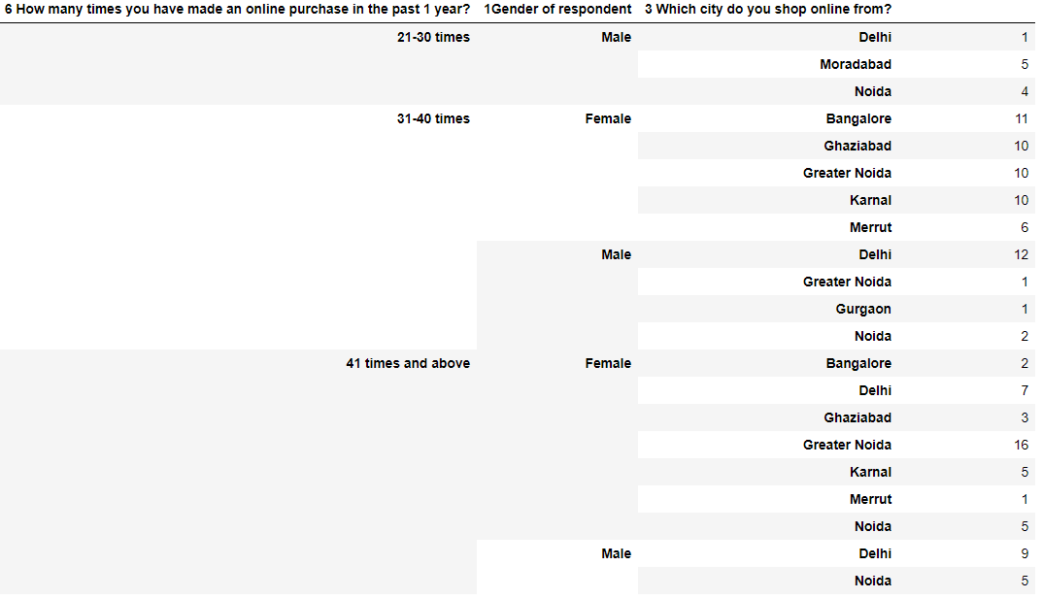
Visualizations done during EDA
Example of Multivariate analysis examples showing data of only high purchase frequency customers

Slide 7
Conclusion/Findings drawn from Univariate Analysis
* Female customers(67%)are more than male customers
* Customers between 20 to 50 years shopped more from the store. 75 % of customers are between 20 to 50
* NCR and Bangalore (67%) are the cities with high number of buyers
* 36% customers were found shopping online for more than 4 years , 24% were shopping for 2-3 years
* IN last one year 42% customers have purchased online less than 10 times,23% cutomers purchased 31-40 times only 2 percent customers purchased more than 42 times
* highest 70% customers used mobile internet for online purchase
* 52% customers used Smartfone for online purchase, 32% used laptop least 4% used tablet
* 45% customers had windows OS on their device of purchase, 32% had Android
* 80% customers used Google chrome for for online purhcase
* 86% customers uses Search engine to reach their favorite online store
* After first visit 32 % customers used search engine to reach online store and 32% used application
* 46% customers take at least 15 minutes before making a purchase, 26% take 6-10 minutes only
* 55% customers prefer Credit/Debit cards to make payments ,28% preferred COD and 17 % preferred Ewallets
* 64% customers not usually abandon their shopping cart, 19% abandon their cart frequently
* 49% customres abandon their bag due to better alternative offer, 20% abandon due to promocode not applicable
* 61% customers have strongly agreed to have easy website content which is easy to understand
* 43% customers likes the information shared in context to similat product ,which is useful in comparison
* 70% customers like to have seller and complete product info to make buying decisions
* 90% customers like to have relevant information on listed products to be started clearly.
* 90% cusotmers like the website to be easily navigable
* 85% cusotmers had no issues with the loading and processing speed
* 87% customers like the website interface
* 90% customers liked the paying methods.

Slide 8
Conclusion/Findings drawn from Univariate Analysis
* 52% customers trust that online store will fufill its part of transaction at stipulated time
* 85% customers like the organization's readiness to assist with queries
* 90% customers belive the retail store to guarantee their privacy
* 90% customers liked the responsiveness of several communication channels
* 70% agree that online shopping gives monetary benefit and discounts to the customer
* 60% customers enjoys online shopping
* 84% customers agree that online shopping is convenient and flexible
* 90% customers agree that return and replacement policy helps them making purchase decision
* aPPROX 50% customers agree that gaining access to loyality program is a benefit of shopping online
* 80% customers like to have quality information on the website
* 95% customers are satisfied while shopping on a good quality website
* 80% customers agree that net benefit derived can improve user satisfaction
* 85% customers agree that customer satisfaction cannot be built without trust
* 70% like to have a wide variety of listed products in several category.
* 86% customers like to have complete and relevant information
* 80% customers agree to receive monetary savings while shopping online
* 50% agree with the convenience of patronizing the online retailer
* 50% customers agree that online shopping give the sense of adventure
* only 30% customers agree that online shopping enhances their social status
* 37% customers like flipkart and amazon in terms of displaying complete and relevant information of the products
* In terms of speed Amazon.in is liked by 90% customers , 60 % like Flipkart , 27% Myntra
* 78% customers trust Amazon to be reliable , 55% likes flipkart , 25% Myntra
* 80% customers likes Amazon's quickness to complete the purchase , 60% likes Flipart's, 30% likes myntra's
* 86% likes Amazon's delivery speed , 56% likes flipkart's , 5% likes myntra's
* 82% customers trust amazon in terms of keeping the privacy of their data, 56% trust flipkart 20% trust myntra , 12 % trust snapdeal
* 70% trust amazon in terms of keeping their financial information secured, 56% flipakrt, 34% myntra , 21% snapdeal , 22@ paytm
* 84% customers believe Amazon perceived trustworthiness, 43% - Flipkart , 33% - Myntra ,snapdeal 27% snapdeal
* 86% customers like Amazon in terms of online assistance through multi channel , 51% -Flipkart ,42% myntra
* 50% customers agree that Amazon takes longer time to log them in while in sales period/promotions , 39% goes with flipkart, 13% goes with myntra , 16%-snapdeal
* 46% customers says that amazon takes londer time in dsiplaying photos in sales/promition , 35%- flipkart, 21% snapdeal, 14% myntra, 11% paytm
* In terms of late declaration of price in promotion/sales --28% goes with myntra, 21% amazon , 16% flipkart , 18% snapedeal, 23% paytm
* In terms of longer page loading in promotion/sales -- 26% customer goes with myntra, 23% -flipkart,23% -amazon,24% snapdeal
* In terms of limited mode of payment on most products during sales period/promotions -- 41% goes with snapdeal, 40% -amazon,23% flipkart, 20% paytm and only 3% myntra . Hence myntra gives most payment options during sales/promotion.
* In terms of time taken in product delivery-- paytm has highest votes of 37%, snapdeal 24%, flipkart 16%, amazon 14% and snapdeal and myntra 10%. hence snapdeal and myntra takes minimum time for delivery among all.
* 20% customers dislikes disruptions while moving to another page on amazon, 24% on myntra, 27% snapdeal, 14% paytm,23% snapdeal
* 61% customers says that amazon website is as efficient as before, 43% for flipkart,22% for paytm,9% for snapdeal
* 81% customers would like to recommend amazon to a friend, 43% would like flipkart , 22% would like for myntra ,9% for paytm and least 4 % would like to recommend snapdeal.

Slide 9
Conclusion/Findings drawn from Bivariate Analysis
* customers with age between 21 to 50 have shopped more number of times from online store
* NCR region contains customers who have shopped dmost number of times
* Most customers who are shopping online from 1 to 4 years have shopped less than 10 times and customers shoppping online for above 4 years have highest purchase count in all more than 10 times group
* Most customers spends more than 15 minutes before making decision irrespective of the purchase count
* Most cutomers who purchased less than 10 times preferred COD as payment option along with credit/debit cards.All customers who purchased more than 10 times preferred credit/Debit cards for payment.
* Most customers who purchased less than 10 times abandoned the cart due to better alternative offer.cutomers purchasing more than 41 times abandoned due to promo code not applied Or better alternative offer
* It can be seen clearly that all customers irrespective of the purchase count strongly agree with the empathy which measn empathy is very important for customer satisfaction and hence retention
* It can be seen clearly that all customers irrespective of the purchase count strongly agree with availability of several communication channels
* All customers irrespective of purchase count agree with online shopping being flexible
* It can be seen that return and replacement policy plays an important role in customer satisfaction
* Customers who have purchased many times (more than 30) agrees that they get benefit of gaining access to loyality programs while shopping online
* Most of the users who have made numerous online purchase agree to have quality information displayed on the site
Customers who have shopped more than 30 times strongly agree that net benefit from online purchase leads to user satisfaction Hence net benefit derived is an important factor for customer retention
* Customers having purchase frequency of more than 30 times strongly agree to get wide variety of listed prodcuts in several category.
* High purchase frequency customers ( >30) strongly agree to have complete and relevant product information
* Cutomers with high purchase (>30) agree to get monetary savings
* Almost all customers with high purchase agree that they get value for money spent.it indicates that quality of product sold plays an important role in customer retention
* Highest number of customers have shopped from amazon, paytm and myntra
* Highets number of customers like amazon, paymt and myntra web page layout
* Highest number of customers like amazon and flipkart in terms of variety of product offered
* Highest number of customers like amazon and flipkart in terms of relevant and complete description of products
* High proportion of high purchase frequency customers like amazon and paytm in terms od website speed
* Highest relaibility is obtianed by amazon and flipkart
* Highest number of customers like Amazon in terms of quickness to complete purchase
* In terms of payment option Amazon, flipkart and myntra are liked most by the high purchase frequency customers
* Amazon stands apart in terms of speed of order delivery and privacy of customers information
* Highest number of customers like amazon,flipkart in terms of security of customer private inforamtion
* Amazon perceived highest trustworthyness of high purchase frequency customers
* Most of customers like amazon in terms of online assistance through multichannel
* Most user claims flipkart to take maximumm login time during sales/promotion
* Highest customers claims myntra to take maximum time in displaying graphics and photos

Slide 10
Conclusion/Findings drawn from multivariate Analysis
* Although we have seen that female customers are the most retended customers , specifically female customers from Greater noida stands highest in retention followed by males of Delhi
* Female's of age group 20 to 50 have contributed most in retention
* Out of most retented customers ,Most time taken by Female before making pruchase decision was more than 15 min
* Out of most retended customers ,Females choose to opt most for ewallets followed by credit/Deit cards
* most retended Female customers abandoned their bag due to better alternative offer,promocode not applicable
* Highest retended customers are from Delhi and of age group 21-30, second highest are again from Delhi of age group 41-50
* Highest retended customers are from Delhi and prefer credit/debit cards for payments, second highest are from Ghaziabad and gr noida pereferring COD and ewallets respectively. hence payment option preferrence varies for retened customers along with city

